Slide 1

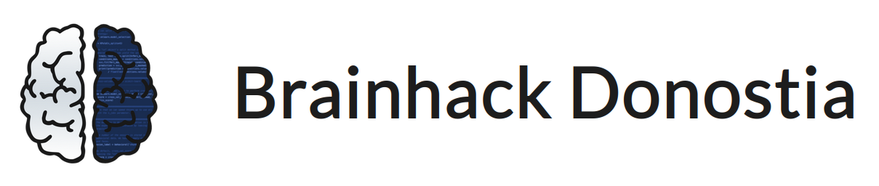
Physiological signal classification
David Romero - Mondragon Unibertsitatea, Spain Stefano Moia - Basque Center on Cognition, Brain and Language, Spain
Mattermost: ~physiopy
GitHub: github.com/drombas/BHD-physiological-classification

Slide 2

physiopy & phys2bids
physiopy: a community-based open development* project to facilitate the adoption of physiological data in (f)MRI experimental settings
phys2bids: our tool to BIDSify physiological recordings
Now: command-line, knowledge driven tool
Future: data-driven tool. Add functionalities to automatically read, understand and process physiological files and their content
*We adopt the all-contributors system: https://allcontributors.org/docs/en

Slide 3
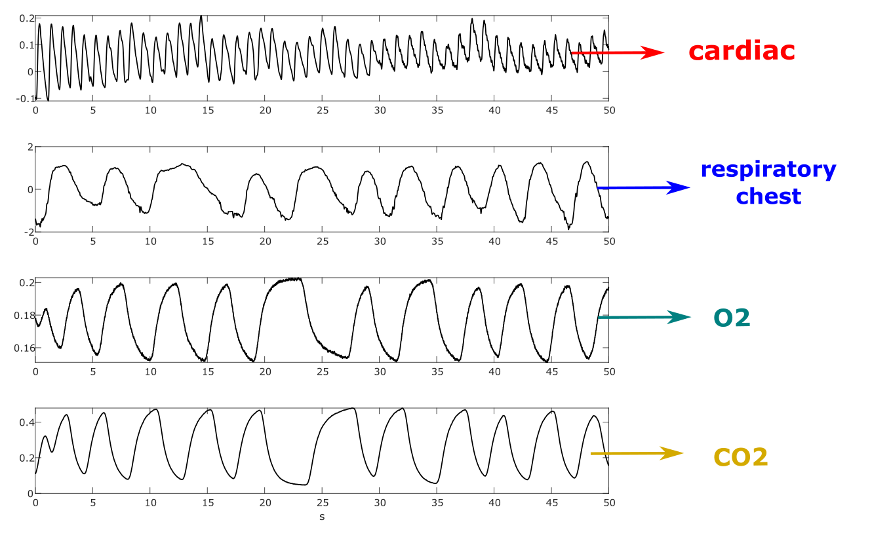

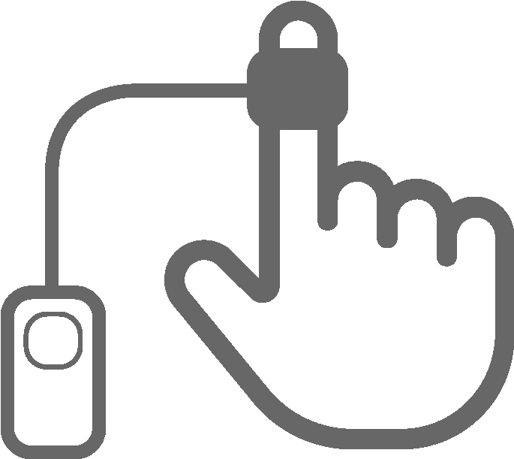

Our project
Physiological data is diverse:
Cardiac
Breathing
Blood gases (O2, CO2)
Skin conductance
…
Goal: automatic classification of signals

Slide 4
Project details
Data description
4 types of signals (cardiac, respiratory chest, O2 and CO2)
240 time-series (60x4) recordings of 500 seconds long
Goals
Build a 4-class time-series classifier
Extra goal: integrate the classifier into phys2bids
Required skills
Basic knowledge of programming (any language)
No need to know Git/GitHub
Interest/experience on: time-series analysis and classification

Slide 5
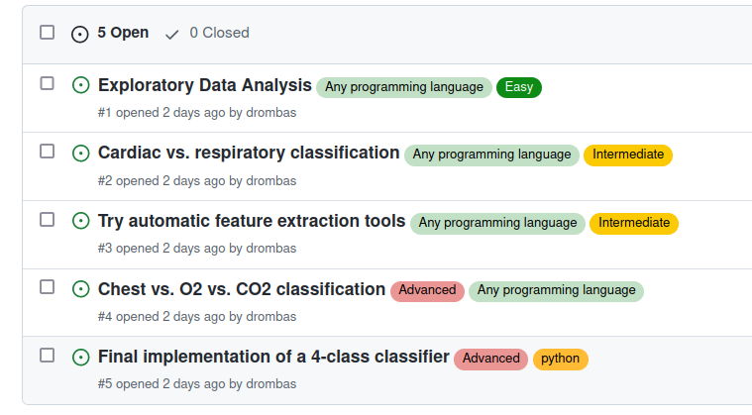
How to get started
Visit the GitHub repo
Take a look at the tasks (issues)
Reach us to agree on a working plan
Download the data and start working!

Slide 6
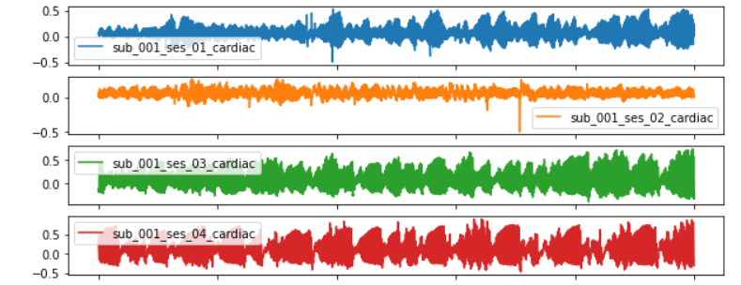
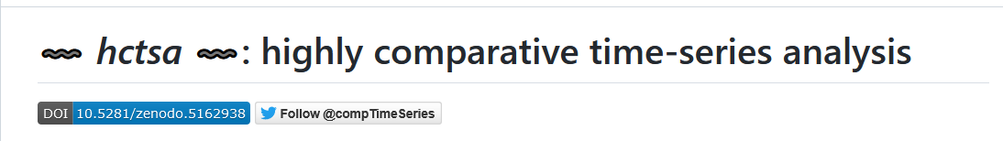
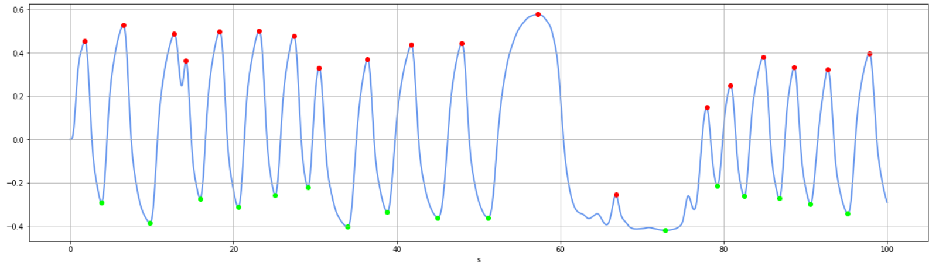
Project update
Done so far
Exploratory data analysis (Akanksha)
Plotted the signals
Found outliers
Visualize mean spectrum
Respiratory vs. cardiac classification
Automatic feature extraction (Inés)
Install and start exploring HCTSA
Test HCTSA
Chest vs. O2 vs. CO2 classification (David)
Implement preprocessing
Extract features
Test classifier

Slide 7
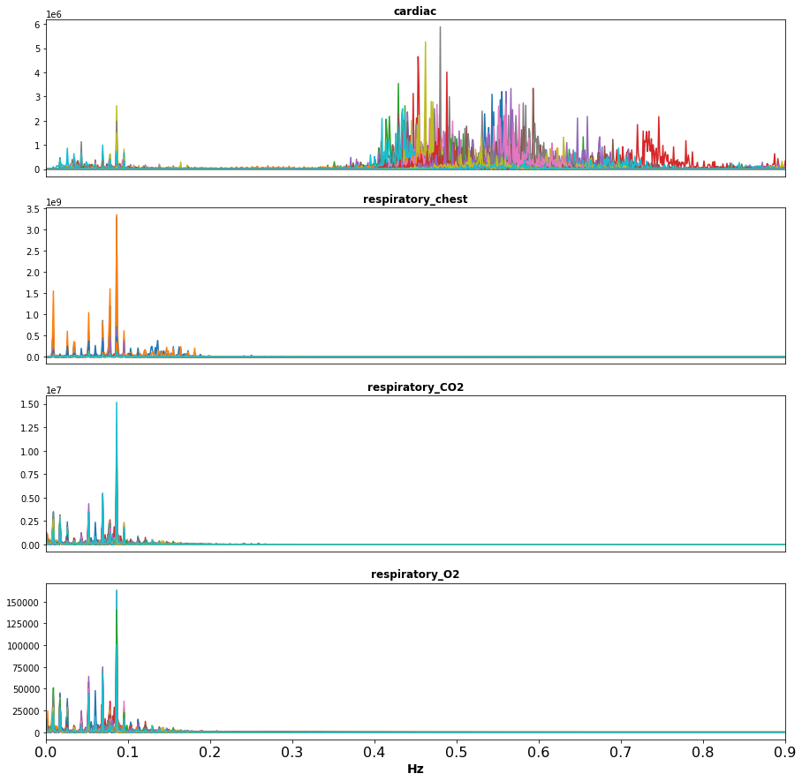
Project wrap-up 1/3
Frequency analysis
Exploratory data analysis (Akanksha)
Visualization and outlier detection
Frequency analysis
Time analysis

Slide 8
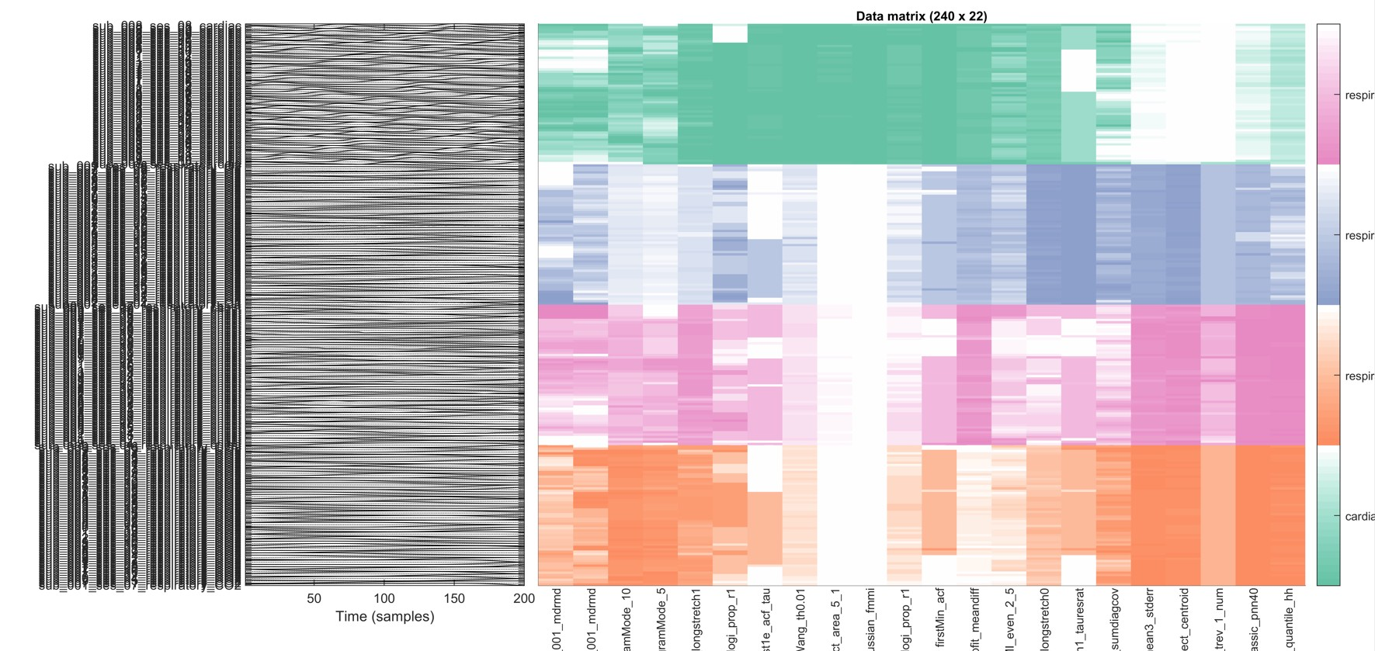
Project wrap-up 2/3
Automatic feature extraction (Inés)
Explored HCTSA
With 22 features → perfect accuracy
Features (columns)
Time-series
(rows)

Slide 9
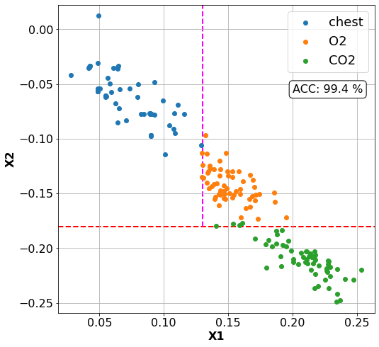
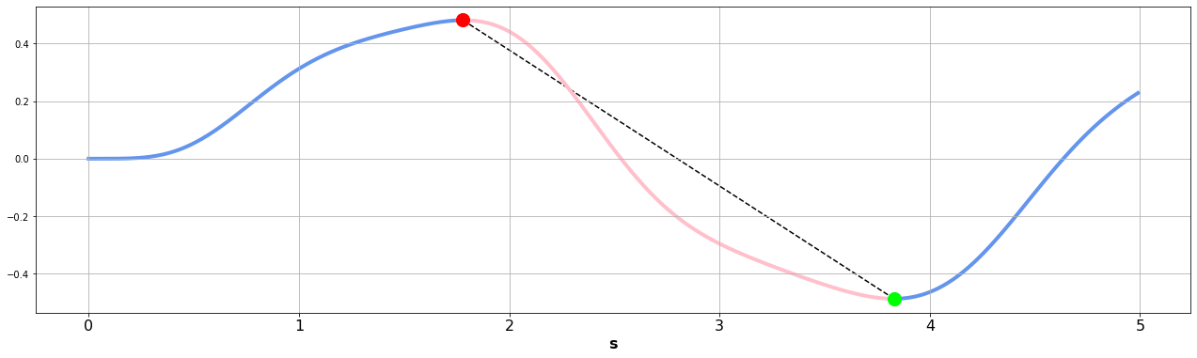
Project wrap up 3/3
Chest vs. O2 vs. CO2 classification (David)
Implement preprocessing
Extract feature: difference from linear function
Basic decision tree classifier

Slide 10
physiopy
physiopy: a community-based open development* project to facilitate the adoption of physiological data in (f)MRI experimental settings
*We adopt the all-contributors system: https://allcontributors.org/docs/en

Slide 11
Physiological signal classification
David Romero (@drombas)
Stefano Moia (@smoia)
Mattermost: ~physiopy
GitHub: github.com/drombas/BHD-physiological-classification

